Slide 1
Overdose Prevention, Recognition and Response

Slide 2
Overdose Prevention
What are the risk factors for overdose?
What are some safety tips for reducing overdose risk?

Slide 3
Overdose Risk
Factors
Individual
How Substance is Taken
Overdose Risk
Overdose?
Substance(s)
Anyone can overdose regardless of their substance use history
Overdose risk is complicated and depends on interaction between several factors
Risk is very individualized: If several different people use the same amount of the same substance, it might affect them all differently

Slide 4
Tolerance
Lower tolerance when you have:
Taken a break from using
Recently been in detox/treatment
Recently been incarcerated
Recently started using
Lung, liver & other health issues (e.g. asthma, COPD, Hep C)
Had a recent overdose

Slide 5
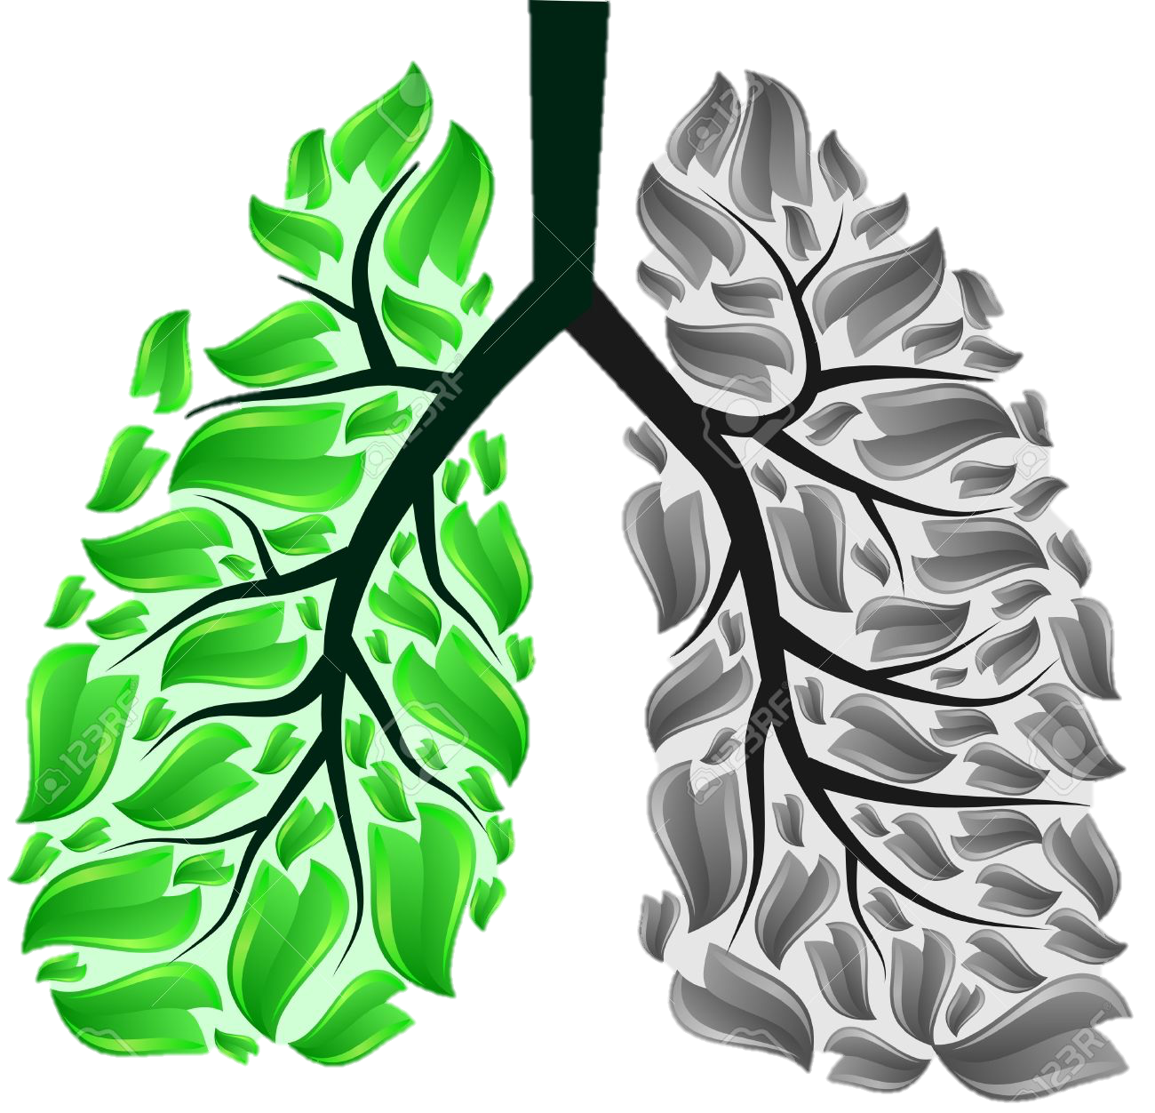
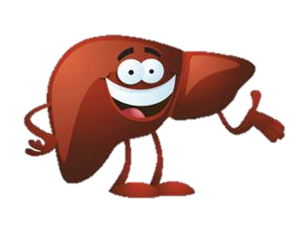
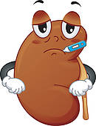
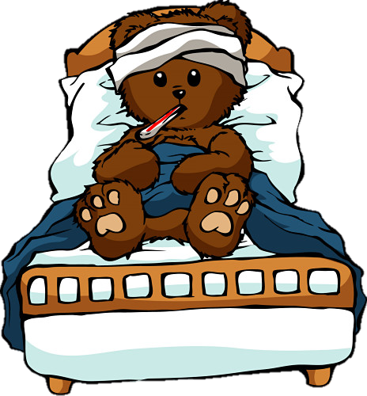
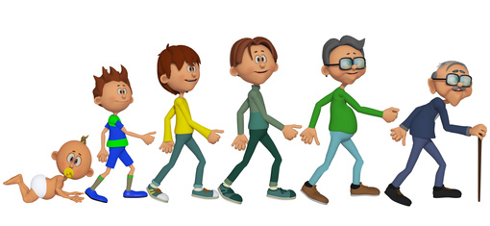
Your health impacts tolerance
Lung, liver and kidney conditions
Recently sick
Age

Slide 6
Take less when tolerance is low
Know your tolerance
Use less
Pace yourself
Do testers
If you have been abstinent, start by using much less

Slide 7
Route of Administration
Regardless of how you take a drug, if you use enough of that drug in a short enough period of time OD is possible
However, some ways of taking drugs are more likely to result in an OD than others

Slide 8
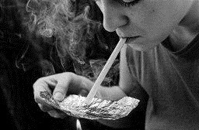
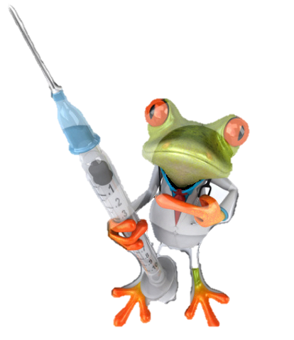
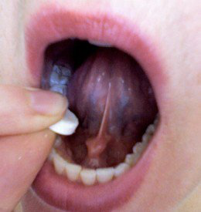
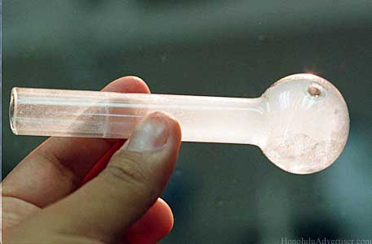
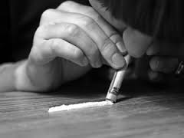
Route of Administration
Use a safer way of taking the drug
Take less if you are injecting
Less Risky
Less Risky

Slide 9
Polysubstance Use
Depressant + Depressant | Depressant + Stimulant
e.g. heroin + alcohol e.g. methadone + benzos e.g. alcohol + benzos | e.g. heroin + crystal meth e.g. alcohol + ecstasy
The majority of unintentional fatal overdoses involve multiple substances, including alcohol and prescribed medications

Slide 10
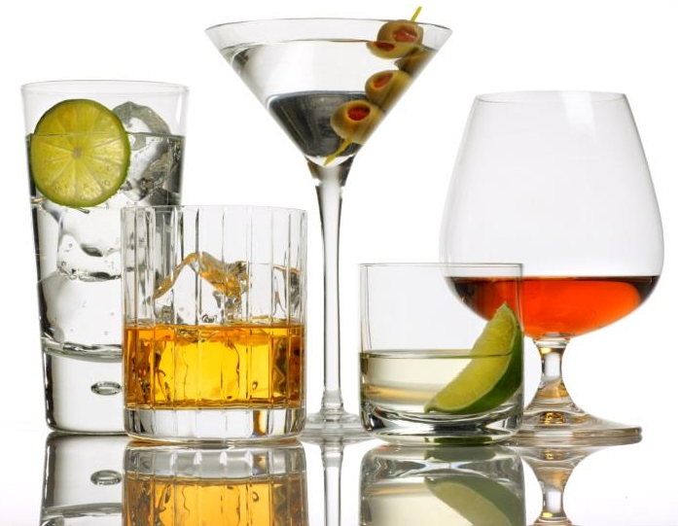
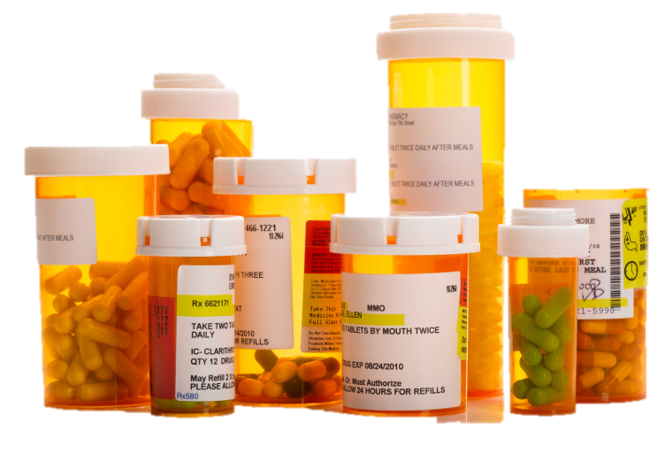
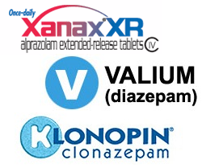
Be careful mixing substances
Do not mix drugs (including prescribed medications) and alcohol.
Be aware that prescribed medication can increase OD risk.
If you do mix, use drugs before alcohol

Slide 11
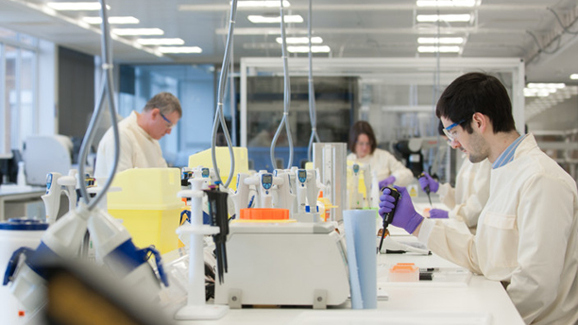
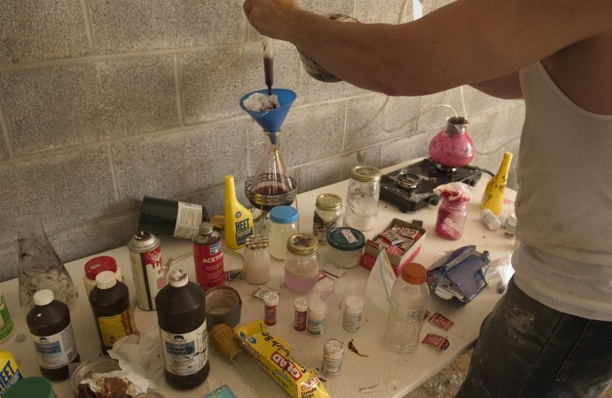
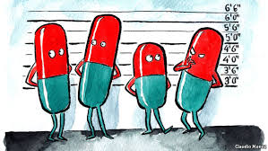
Strength and Content Varies
vs
Unregulated drug market
No quality control for illicitly obtained drugs

Slide 12
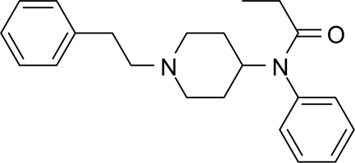
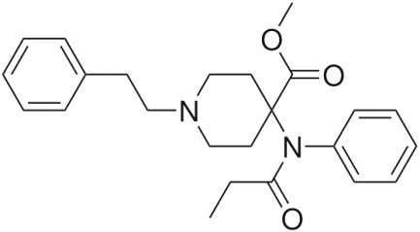
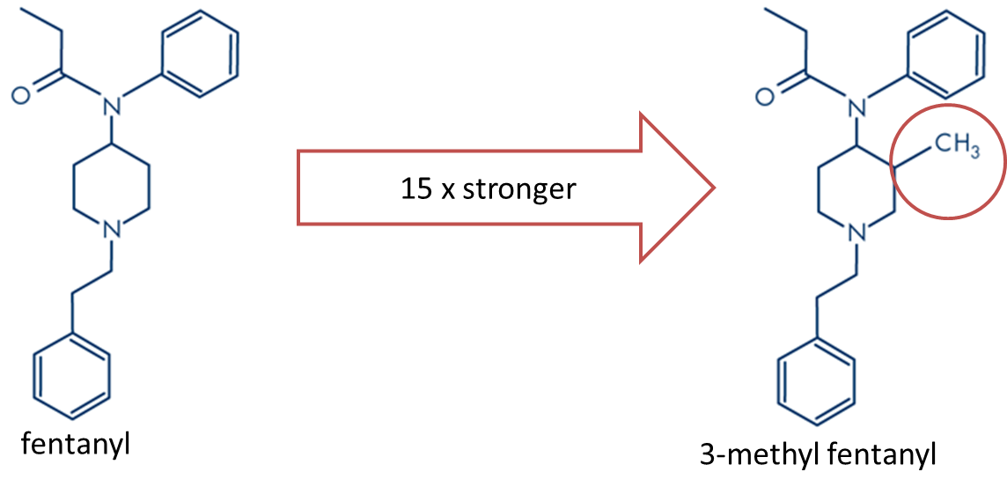
Strength and Content Varies
CH₃
1.
100 x more toxic
fentanyl
carfentanil
more toxic
You cannot know for sure what you are purchasing if you use illicitly obtained substances
Small variations could be lethal if a toxic drug is present

Slide 13
Variable strength and content
Be aware that strength will vary.
Especially true if there have been changes in supply, dealer or community
Do testers to check strength.

Slide 14
Using Alone: risk factor for fatal overdose
If you use alone, no one can call for help or give naloxone if you overdose
Why might people use alone?
Stigma
Fear
Preference

Slide 15
Safety Tips
Plan ahead
Develop an OD plan before use
Don’t use alone
Fix with a friend (not at the same time)
If you use alone, it is safer to…
Leave the door unlocked or slightly ajar
Call or text someone you trust and have them check on you

Slide 16
A crash course in drugs
Classification of substances based on effects

Slide 17
Classification of Substances
What are some stimulants (uppers)?
What are some depressants (downers)?
What are some hallucinogens?

Slide 18
Name some opioids…

Slide 19
What is an opioid?
Class of drugs (prescribed or used illicitly)
depressants
May be used to:
Reduce pain
Manage opioid dependence
Produce temporary euphoria/relaxation

Slide 20
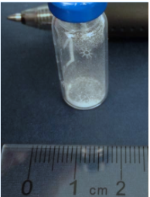
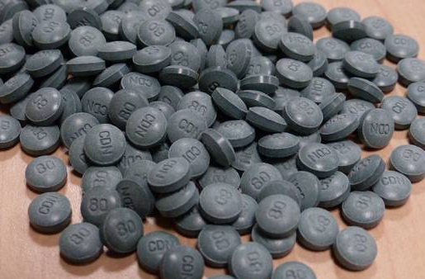
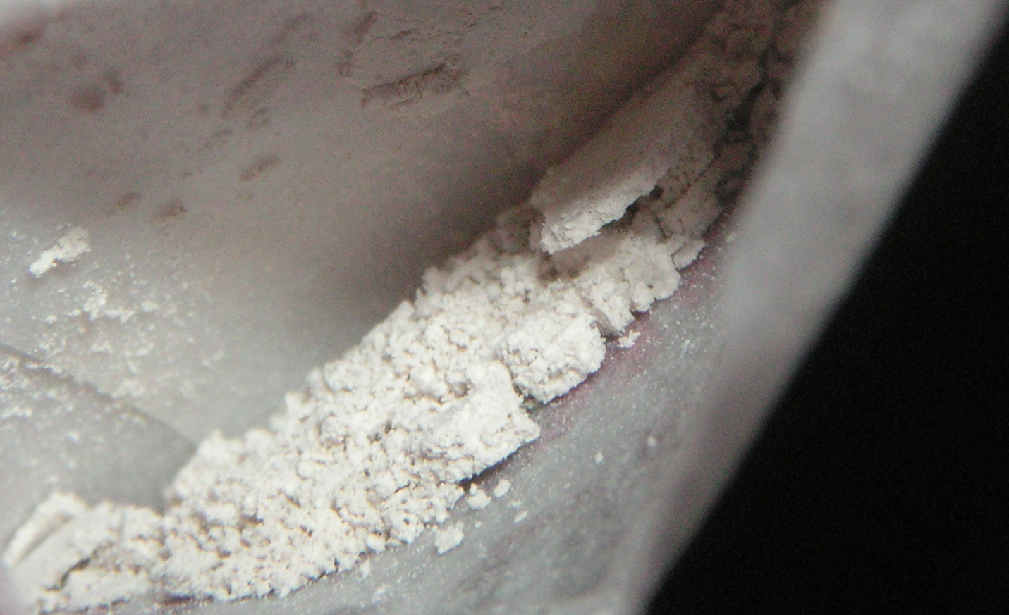
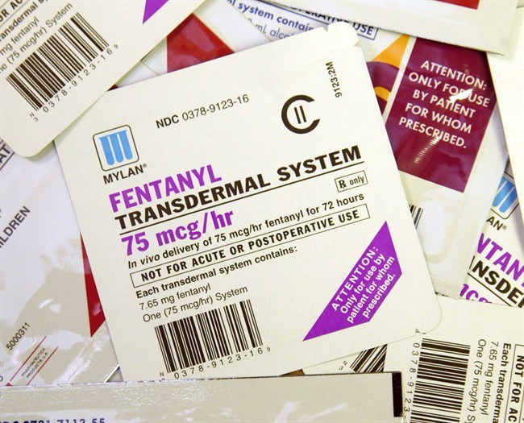
Fentanyl
Used medically as a painkiller or anaesthetic
50-100 times more toxic than morphine
Estimated lethal dose of pure fentanyl is 2mg
Illicit fentanyl can be sold as fentanyl, heroin, or fake oxys OR any street drug may be intentionally or unintentionally contaminated
Taken intentionally or unknowingly

Slide 21
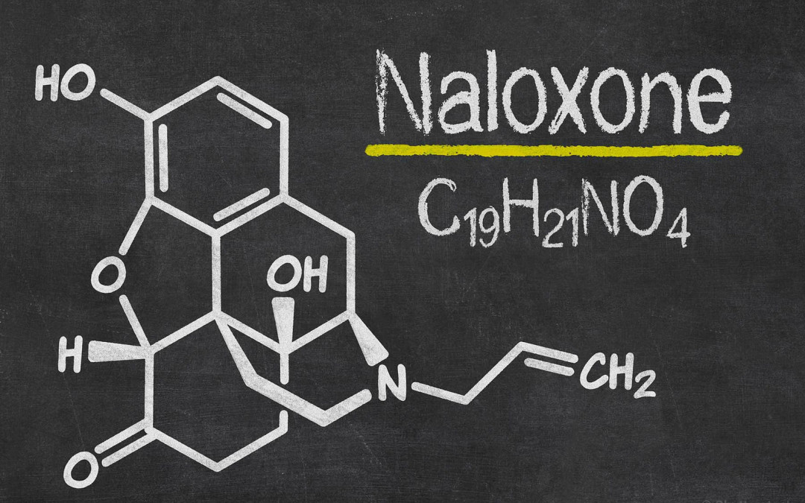

Slide 22
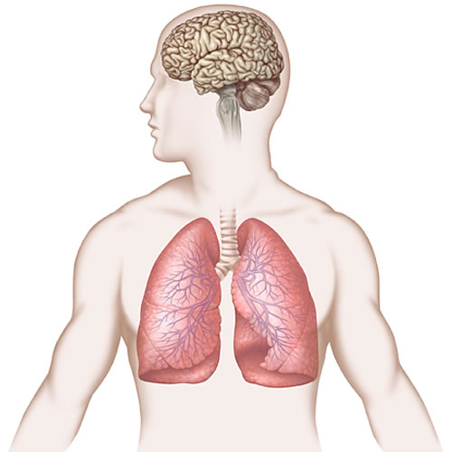
Why is it dangerous to take too much of an opioid?
Lose the urge to breath
Breathing slows decreasing oxygen to the brain
Can lead to permanent brain injury or death if untreated

Slide 23
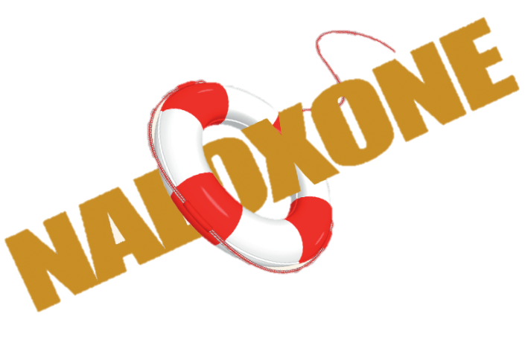
What is naloxone (Narcan®)?
Temporarily reverses slowed breathing from too much opioids
Does NOT work for non-opioid ODs
Can help if multiple substances involved

Slide 24
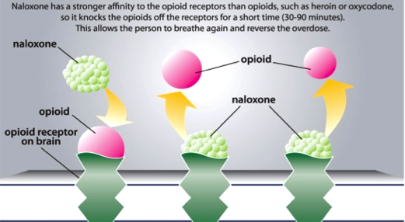
How does naloxone work?
If too many receptors are attached to opioids, breathing slows or stops
Opioids are displaced by naloxone NOT destroyed

Slide 25
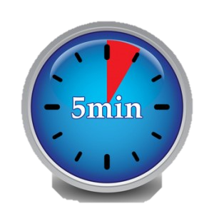
What does naloxone do?
Restores normal breathing in 2-5 minutes
Effects last 30-90 minutes
During this time taking more opioids will have no effect
Overdose can return

Slide 26
How long does naloxone work for?
An overdose can return!
A person’s high will return.
Naloxone

Slide 27
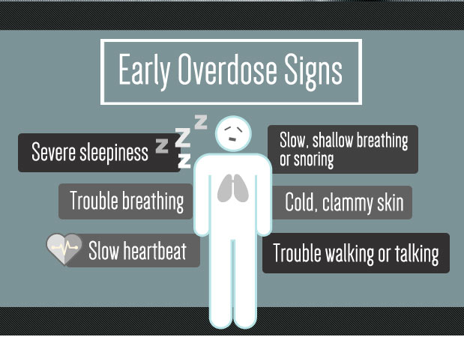
Recognizing Opioid OD
Key Features:
Unresponsive
Slow breathing
May also have:
Small pupils
Snoring or gurgling
Blue lips, fingernails
Cold clammy skin

Slide 28
Non-Opioid ODs
Stimulant
Fast pulse, rapid heartbeat, short of breath, chest pain
Body is hot
Agitation, confusion, hallucinations, unconscious
Non-Opioid Depressants
Looks much like an opioid OD
Naloxone won’t help but won’t hurt

Slide 29
Responding to Opioid Overdose

Slide 30
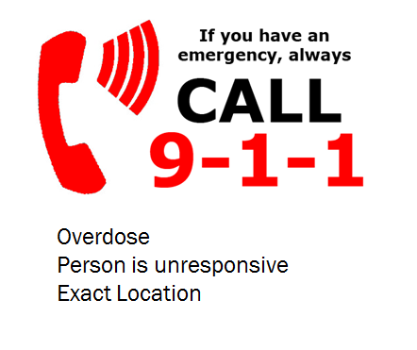
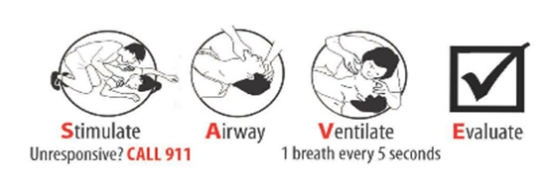
Overdose Response - no naloxone
If you see someone overdose, giving breaths is enough to keep someone alive until help arrives
If someone has recently overdosed, they have become unconscious due to lack of oxygen even though their heart is still beating. Therefore, it is important to put oxygen into their blood by breathing for them.
Always tell the person who overdosed what you are doing before you do it

Slide 31
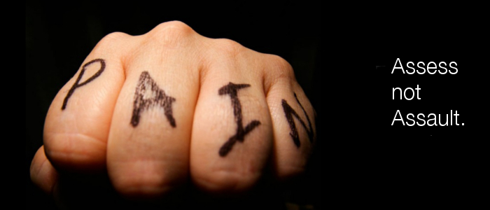
Stimulate
VOICE
Shout their name
Tell them to wake up
Tell them to take a breath
Say Narcan or Police
PAIN
Do a sternal rub
Don’t slap
Tip: Always tell the person what you are going to do before you do it
SAVE ME

Slide 32
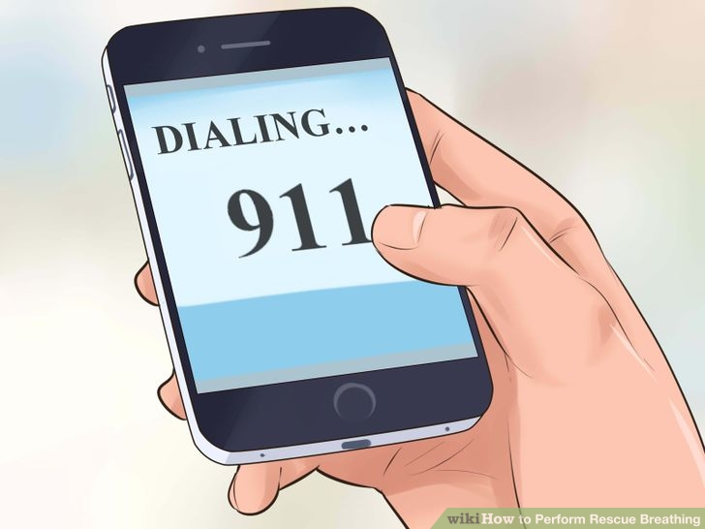
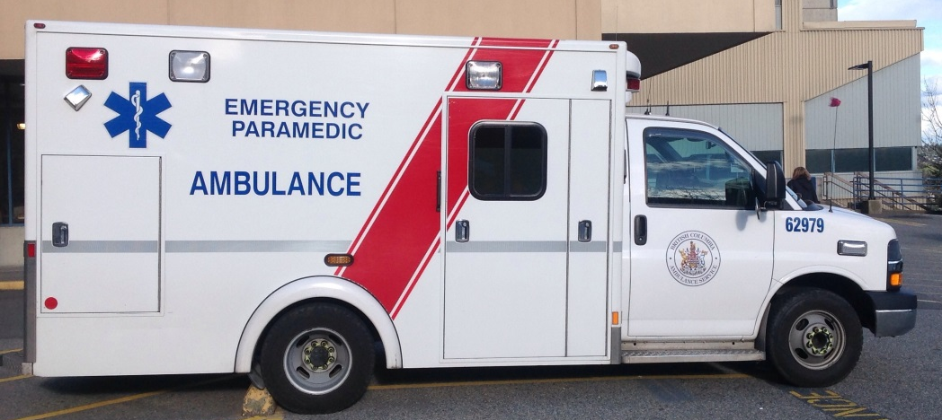
911
Someone is unresponsive and not breathing
Give your exact address
If possible send someone to front door to show paramedics in

Slide 33
Recovery Position
If you have to leave the person at any time (to get naloxone, to call 911, etc.), place them in the recovery position

Slide 34
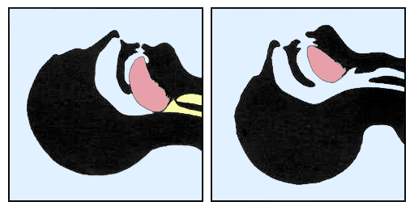
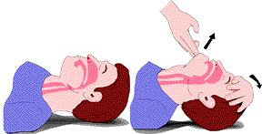
Airway
Make sure nothing in mouth
Tilt head back
SAVE ME

Slide 35
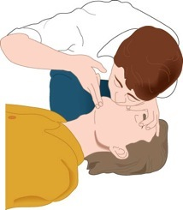
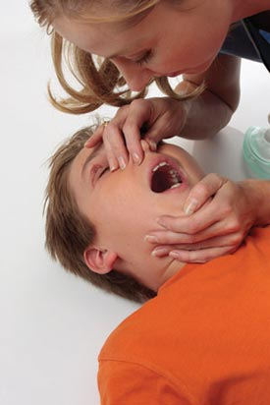
Ventilate
Pinch nose
Start with 2 breaths
1 breath every 5 seconds
CRUCIAL to prevent brain injury and death
SAVE ME

Slide 36
What if you are told to give chest compressions (CPR)?
Rescue breathing is a crucial part of the response to an opioid overdose
If the person has a pulse, compressions are not necessary (but will not cause harm either)
If you do not know how long someone has been unconscious for chest compressions may be necessary.
Failing to provide breaths (with or without compressions) increases the risk of brain injury from lack of oxygen

Slide 37
Evaluate
Has the person started to breath on their own again?
SAVE ME

Slide 38
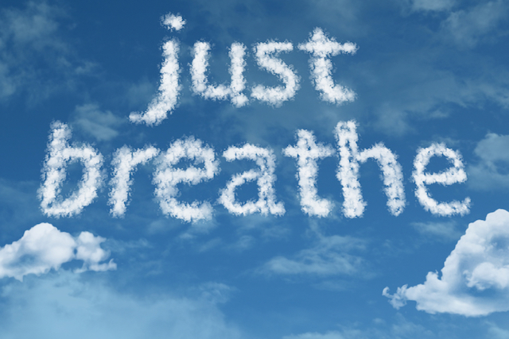
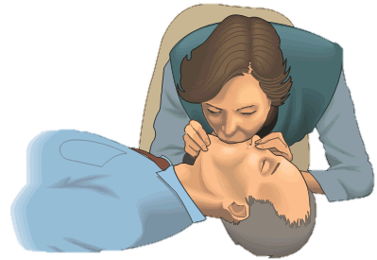
Overdose Response - no naloxone

Slide 39
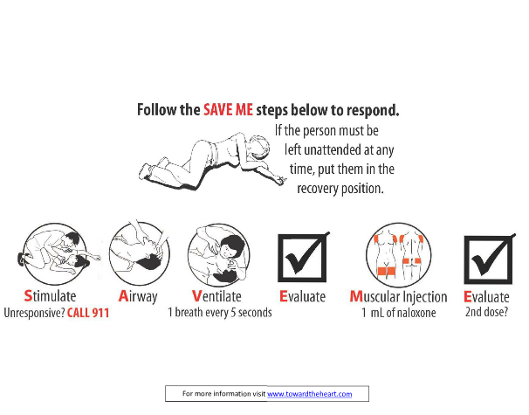
Responding With Naloxone
Always tell the person who overdosed what you are doing before you do it

Slide 40
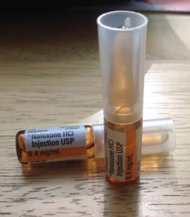
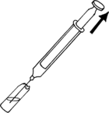
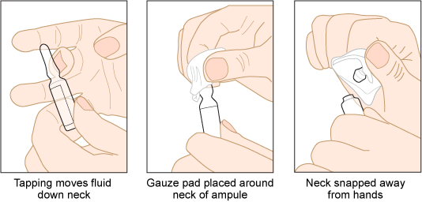
Muscular Injection
Tap or swirl all medication to the bottom
Snap away from you (gentle but firm)
Draw up all fluid into the Vanishpoint syringe
Remove most of the air
SAVE ME

Slide 41
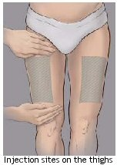
Muscular Injection
At 90 degrees into large muscle
Thigh (recommended)
Upper Arm
Butt
It is ok to inject through clothes
Be firm and steady – no windup necessary, the needle could bend
Push the plunger all the way until you hear a click (probably much further than you would expect)
SAVE ME

Slide 42
Evaluate
Has the person started to breath on their own again?
SAVE ME

Slide 43
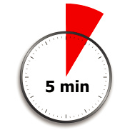
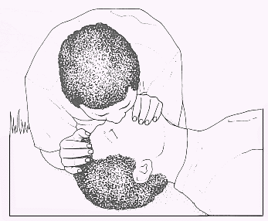
Evaluate
Wait at least 4 minutes
Continue breaths
Approximately 40-50 breaths before you consider a second dose
4 -

Slide 44
Evaluate
Goal is for someone to be breathing on their own (at least 1 breath every 5 seconds)
It is OK if they are not fully conscious
Give as little medication as possible to restore breathing
Less likely to cause opioid withdrawal
More likely to go to hospital for proper treatment
If not breathing regularly after 4-5 minutes, give a 2nd dose

Slide 45
Aftercare
If the person becomes responsive
Tell them what happened
Tell them that naloxone will wear off
Prevent them from using again
Support through withdrawal/dope-sickness

Slide 46
Aftercare
Tell Paramedics:
How long person has been unresponsive
Known medical conditions
Drugs used
How much naloxone given

Slide 47
Questions?
Thank you!

